Slide 1
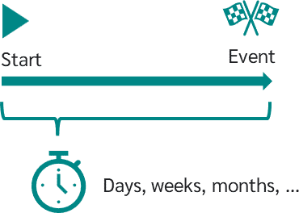

SURVIVAL ANALYSIS
-Aishwarya Madan. Borkar

Slide 2



Prasanta Chandra Mahalanobis
Ronald fisher
Kaplan-Meier

Slide 3
What is SURVIVAL ANALYSIS
A branch of Statistics focused on analyzing the time to an event.
Examples:-
Time until equipment failure
Time until recurrence/relapse of cancer.
Time until death.

Slide 4
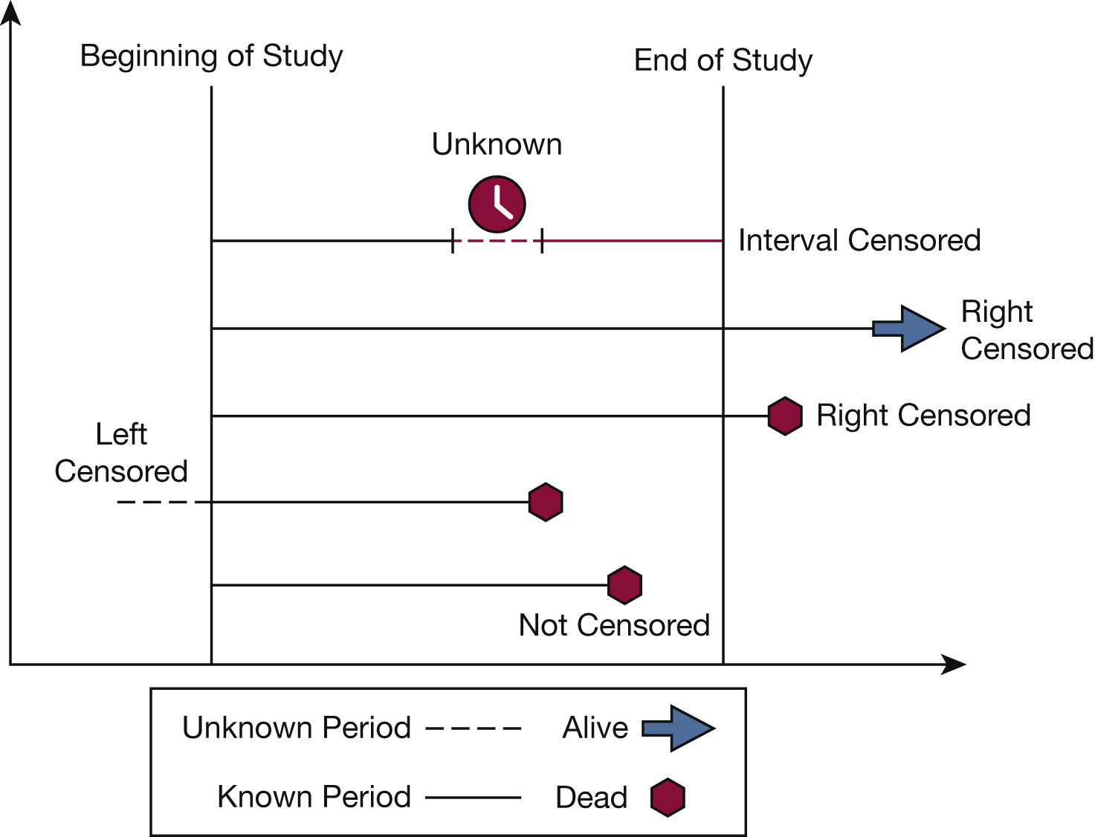

Slide 5
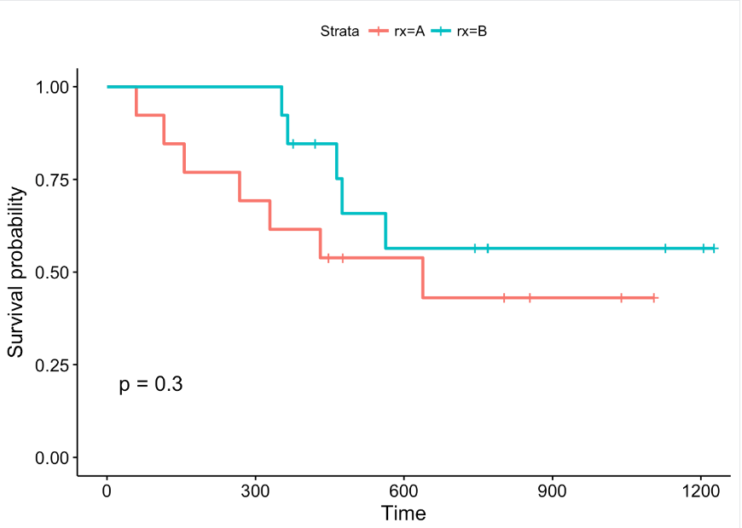

Slide 6

Survival Analysis of Adult Tuberculosis Disease
Olurotimi Bankole Ajagbe, Zubair Kabair, Terry O’Connor
Department of Public Health and Epidemiology, University College Cork, Cork, Ireland.
Mercy University Hospital, Cork, Ireland.

Slide 7
Introduction
Tuberculosis (TB) remains a major global health problem. It causes ill health among millions of people and ranks as the second leading cause of death from an infectious disease worldwide after human immunodeficiency virus (HIV).
Many studies have been conducted on TB; however, there are few studies that focus specifically on survival analysis of TB patients.
Survival analysis is generally defined as a set of methods for analysing data where the outcome variable is the time until the occurrence of an event of interest.
The specific difficulties relating to survival analysis arise largely from the fact that only some individuals have experienced the event and, subsequently, survival times will be unknown for a subset of the study group. This phenomenon is called censoring.
A survival analysis of all bacteriologically confirmed cases of adult TB disease in County Cork. Ireland was conducted.The aim of this study was to estimate survival time (ST) including median time of survival and to assess the association and impact of covariates (TB risk factors) to event status and ST.

Slide 8
HYPOTHESIS
The null hypothesis for the log-rank test is as follows:-
H0:There is no significant difference between the two survival groups.
Vs
H1:There is a significant difference between the two survival groups.

Slide 9
Methods and Data Collection
This is a retrospective cohort research study which tries to analyse the survival of adult TB disease of patients that was treated in County Cork, Ireland.
Inclusion criteria were definite case of TB which was defined as a patient in whom TB had been confirmed by bacteriology (either by culture or with sputum smears positive for acid fast bacilli (AFB+).
Inclusion of patients who were 18 years and above as at the time of diagnosis and had diagnosis and treatment between between January 2008-December 2012.
The Data were collected by the National Tuberculosis Notification form in conjunction with HPSE in Ireland.
The analysis was carried out using SPSS software version 15.0

Slide 10
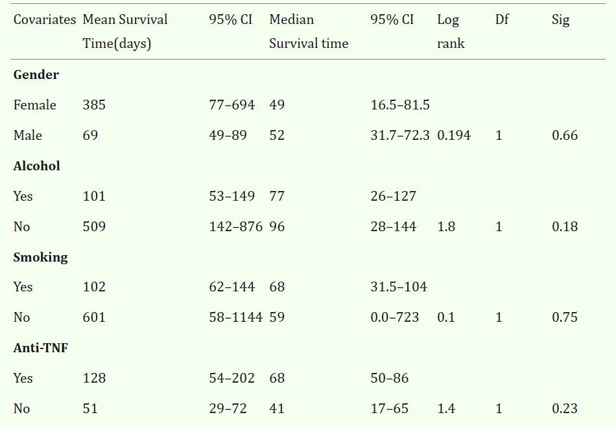

Slide 11
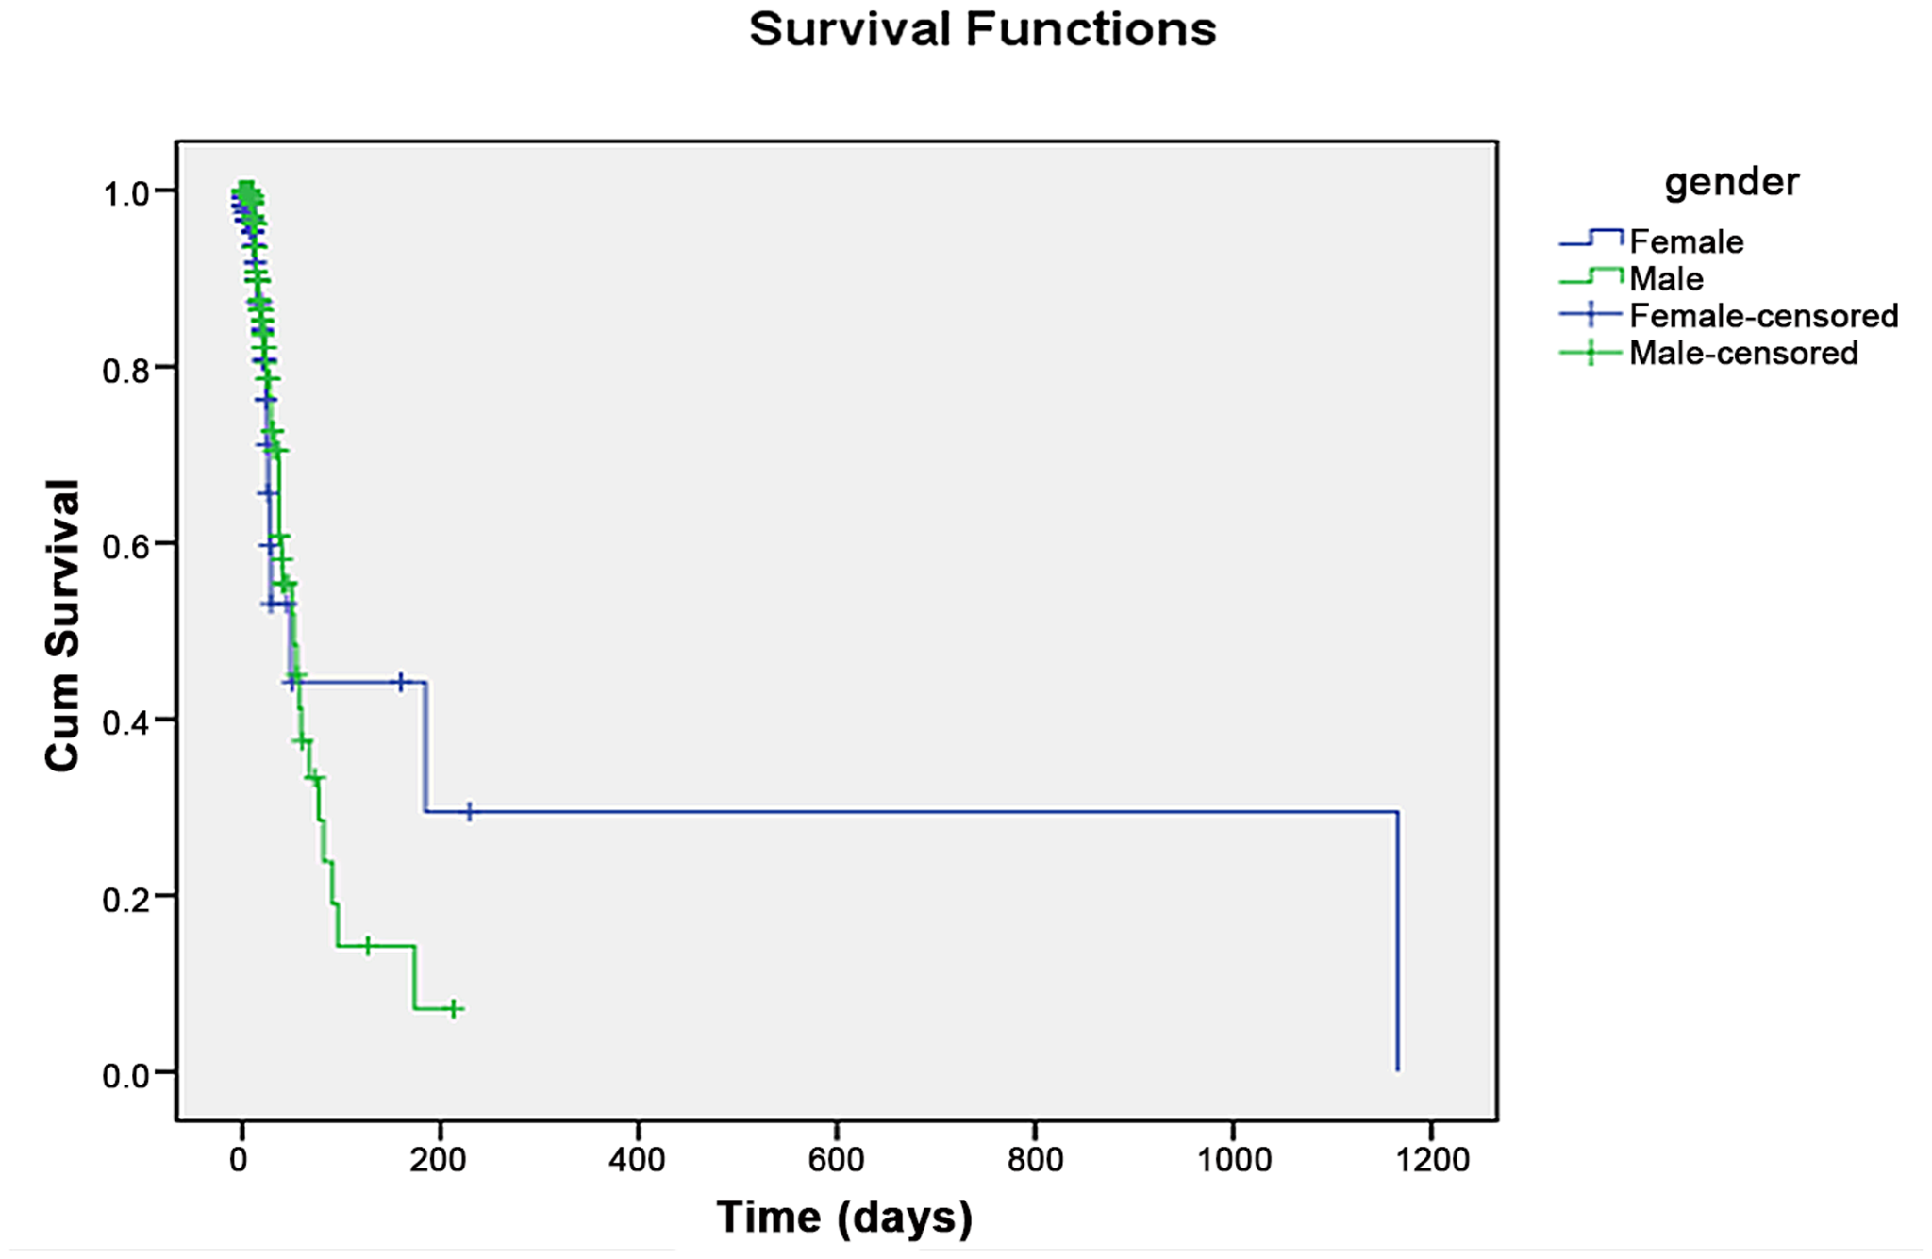
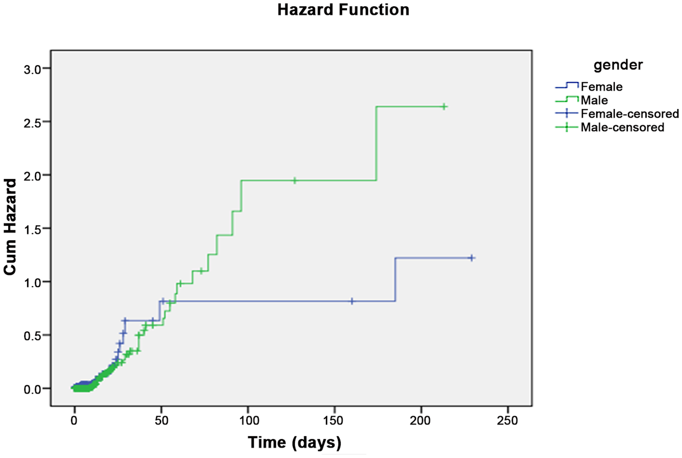

Slide 12
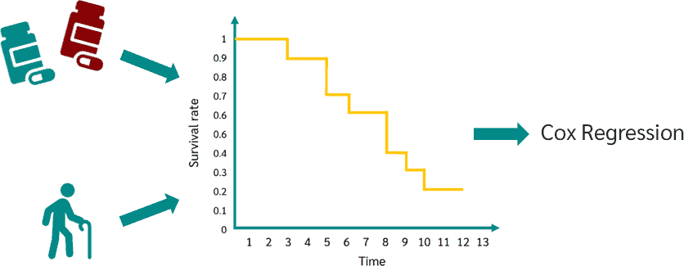
Kaplan-Meier curves and log-rank tests are useful only when the predictor variable is categorical (e.g. treatment A vs treatment B; males vs females). They don’t work easily for quantitative predictors such as gene expression, weight, or age.
An alternative method is the Cox proportional hazards regression analysis, which works for both quantitative predictor variables and categorical variables. Furthermore, the Cox regression model extends survival analysis methods to assess simultaneously the effect of several risk factors on survival time.

Slide 13
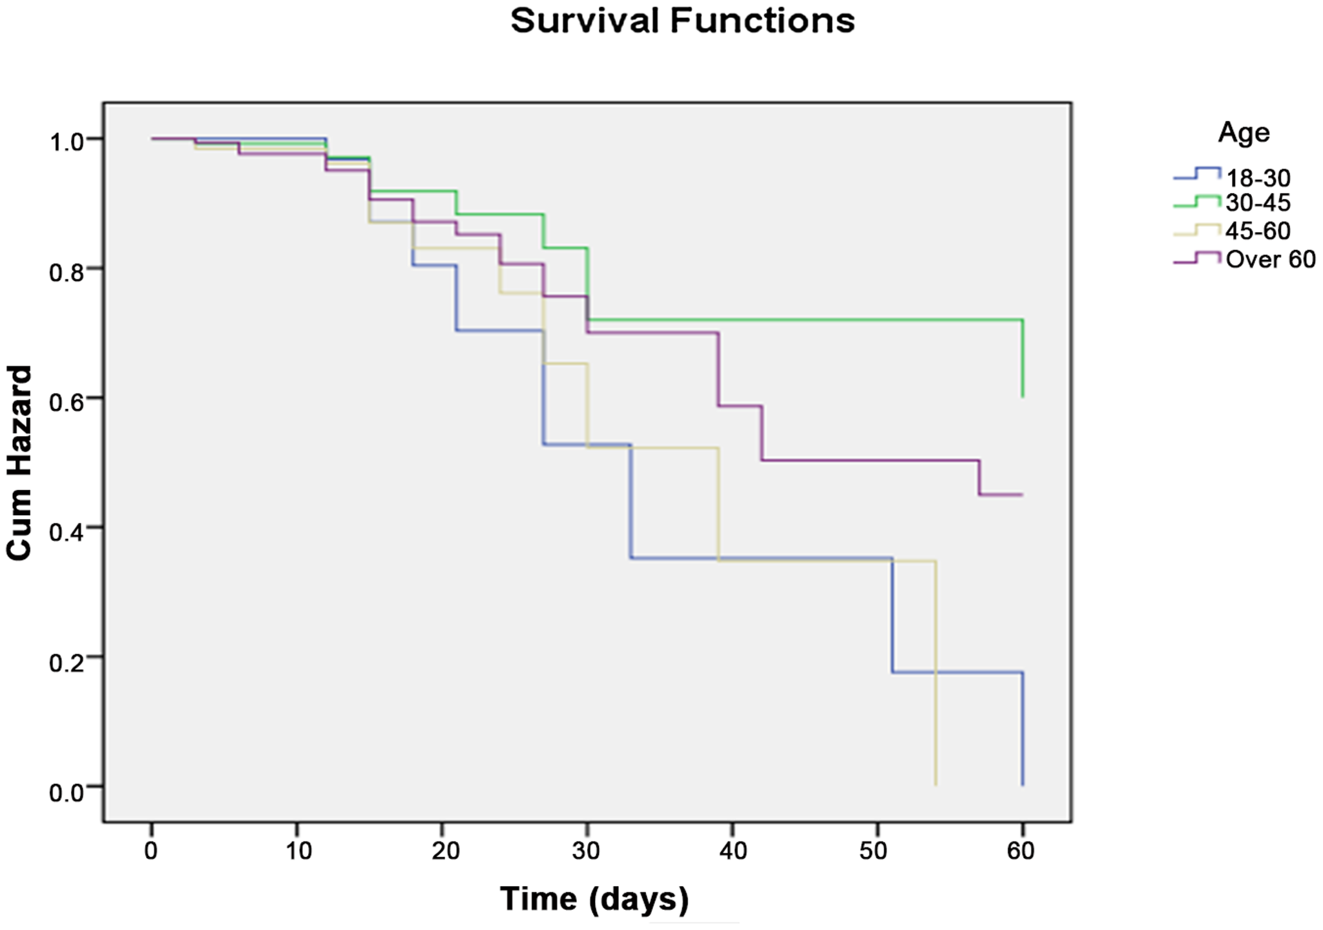

Slide 14
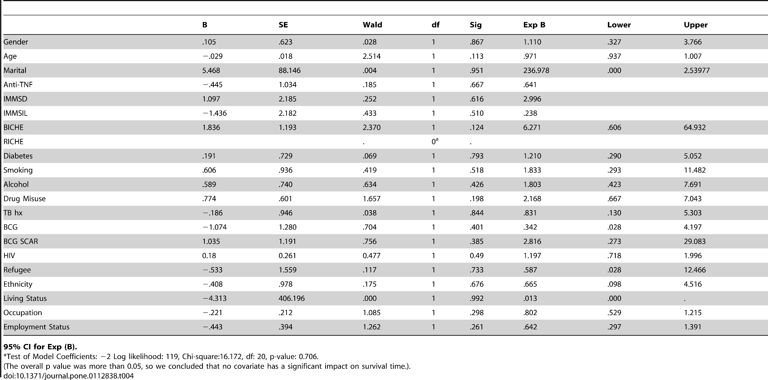

Slide 15
Conclusions
There was no significant difference in survival curves of male and female and among age group.
Women had a longer ST compared to men. But men had a higher hazard rate compared to women.
AntiTNF , IMMSD and diabetes were found to be associated with longer ST, while alcohol, smoking, RICHE, and BICHE were associated with shorter ST.
The association was however not statistically significant as the p-value was greater than 0.05.

Slide 16
REFERENCES
1.World Health Organization Report(2013)Global Tuberculosis report.
2.Health Protection Surveillance centre(2013)TB Cases notified in Ireland in 2011 provisional data.A report by the Health Protection Surveillance Centre.
https://journals.plos.org/plosone/article?id=10.1371/journal.pone.0112838#
http://scholar.google.com/scholar?q=TB+cases+notified+in+Ireland+in+2011.+Provisional+Data++2013
3.Wang J, Shen H (2009) Review of cigarette smoking and tuberculosis in China: intervention is needed for smoking cessation among tuberculosis patients. BMC Public Health 9: 292.
https://journals.plos.org/plosone/article?id=10.1371/journal.pone.0112838#
http://scholar.google.com/scholar?q=Review+of+cigarette+smoking+and+tuberculosis+in+China%3A+intervention+is+needed+for+smoking+cessation+among+tuberculosis+patients+Wang+2009

Slide 17
Resources TO LEARN DATA SCIENCE
KRISH NAIK
PROF.RYAN AHMED
STATQUEST
RITVIKMATH
KDNUGGETS

